Slide 1



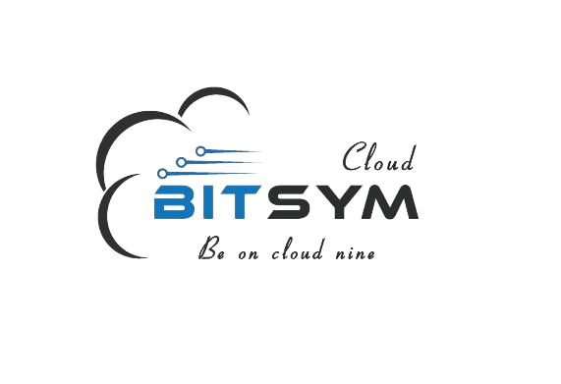
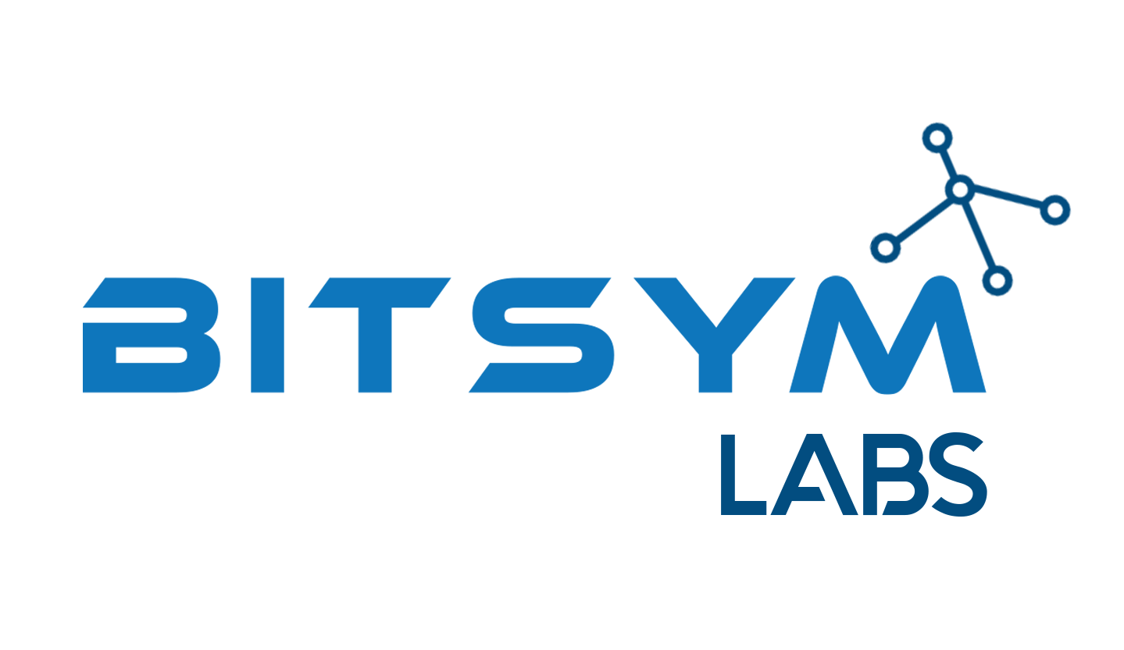


BITSYM
BITSYM PORTFOLIO
Welcome to the realm of BITSYM, where boundless creativity meets unparalleled expertise.

Slide 2
BITSYM
Our mission
Our mission is to make an impact in the lives of millions through science and in the process create wealth to elevate the masses out of poverty.
Our vision
To be One Stop Global Digital Solutions Company

Slide 3
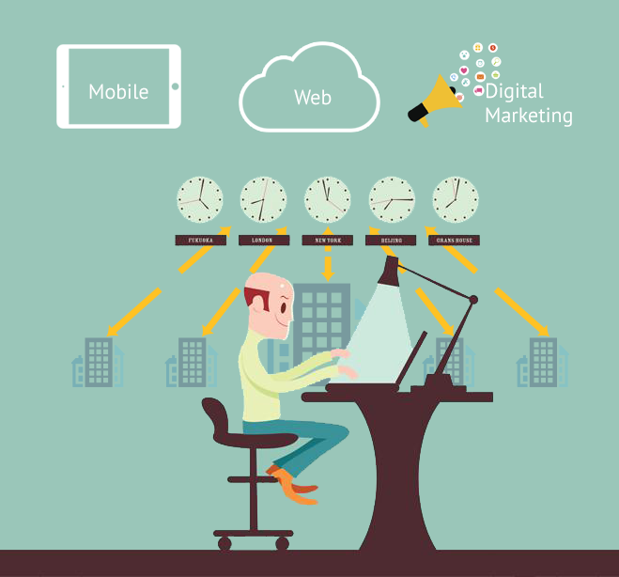
BITSYM
Who are we?
We are pioneers in applying science and engineering for an impact where it matters the most.
Bitsym has a team of highly qualified research scientists, engineers and innovators working with us on finding the right solutions today for a better tomorrow.

Slide 4
BITSYM
What we do?
Bitsym has laser sharp focus on 6 key areas of technological advancement:
Telecommunications and Network
Artificial Intelligence
Semiconductors
Digital Security
Computing
Software Solutions
To create the most innovative techniques towards faster and greater connectivity of humans and machines.
Being at forefront of Artificial Intelligence & Machine Learning
From chip design, verification and testing to embedded devices, smart surfaces and materials, we do our part create the future.​
An active security team designing techniques, algorithms and hardware
Be it computing at the cloud, network edge, handheld computing or quantum computers, Bitsym Labs innovates in all computing spheres to remain at the forefronts of knowledge and discovery.​
Bitsym Software Solutions team specializes in latest tools and technologies with best methods and practices of software engineering and an ISO/CMMI certified portfolio of projects.
Exploiting data, statistics, mathematical modelling and optimization techniques towards provision of intelligent solutions.​
Ensures the digital infrastructure is safe from any internal and external threats.​

Slide 5
BITSYM
How we do?
Our 6-D Process
01
02
03
Discover
We discover
Define
We define the scope
Design
We use best practices in engineering and software design to come up with best possible designs.
04
05
06
Develop
Our development team creates work packages and sprints and develops your solution in optimal timeframes.
Deploy
We conduct extensive deployment testing before anything leaves our premises for production.
Deliver
We deliver our solutions to our valued partners with extensive post delivery support to ensure an optimal customer experience.

Slide 6
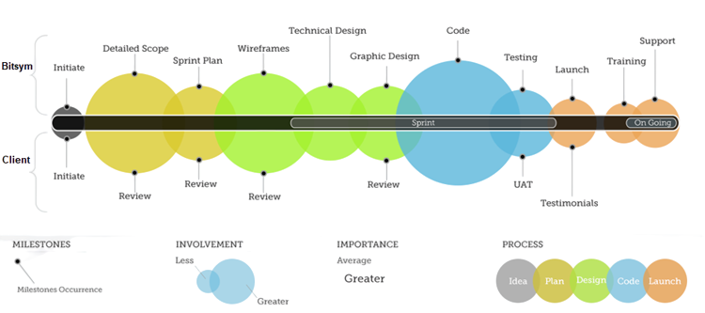
BITSYM
Our Process

Slide 7
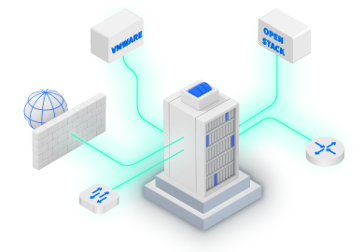

BITSYM
Our Services
Software Development
App Modernization
Cloud Migration
Managed Services
Cloud Security
Enterprise Security
Data Analytics AI/ML
Device Development
Firmware Development
Data Lakes and Recommendation Engines
Predictive analytics
Telecom Infrastructure Design
Chip Design
Digitization
Custom R&D
Custom Solutions
Consultancy

Slide 8
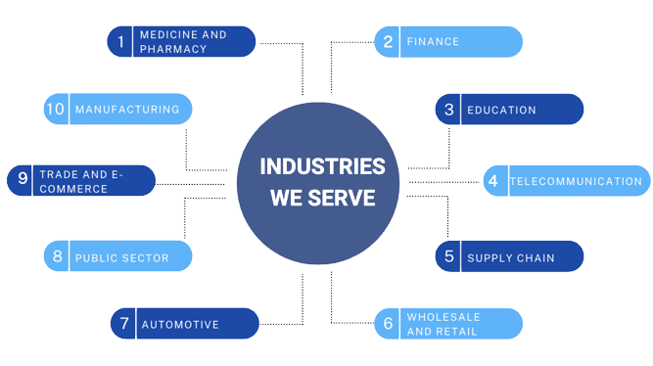
BITSYM

Slide 9
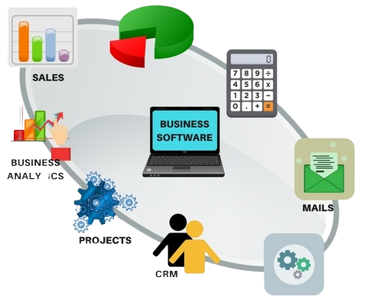

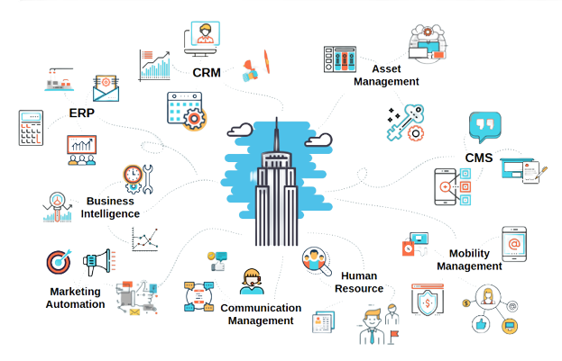

BITSYM
Digital Security

Slide 10
BITSYM
Artificial Intelligence

Slide 11
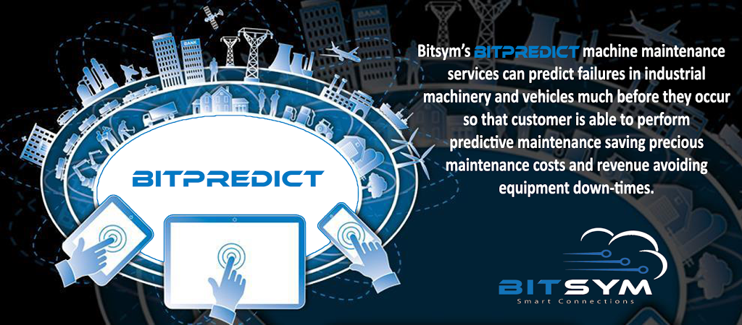
BITSYM

Slide 12
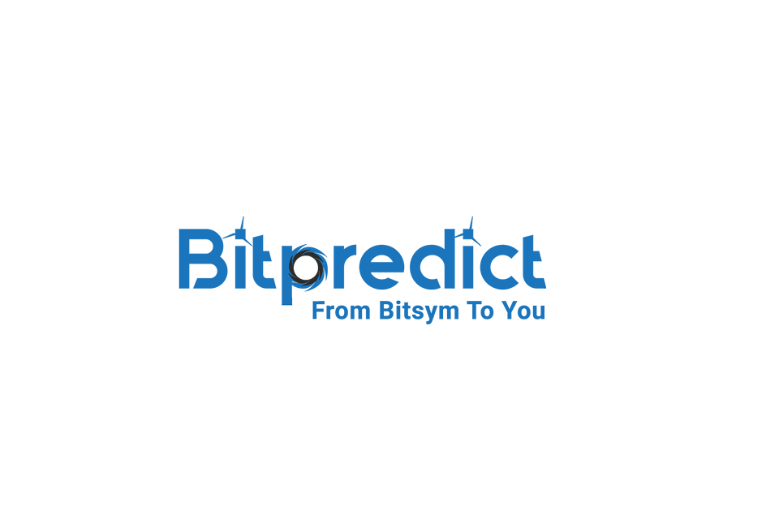
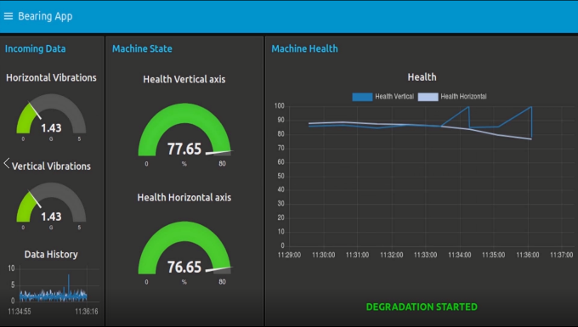
BITSYM
Business Challenge:
To predict the failure of key industrial equipment and machines ahead of time
Business Aims:
Planned maintenance of machinery
Savings via reduced machine downtime
Savings through larger
Solution:
Acquisition of machine data through sensors and machine logs
Predictive modelling of machine data

Slide 13
BITSYM
Successfully Delivered projects:
Hydraulic System Fault Prediction
Brakes System Fault Prediction
Engine Fault Prediction
Electrical System Fault Prediction
Server Crash Prediction
Battery Prognostics
RUL Prediction
Like hydraulic systems, we have also worked successfully with promising results on:
Brakes System
Engine
Electrical System

Slide 14
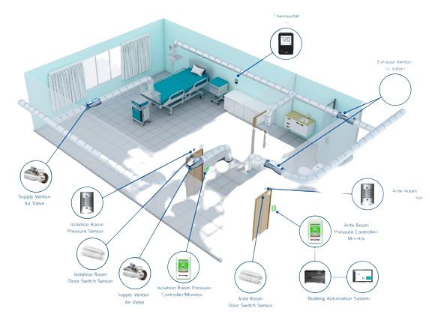
BITSYM
HVAC System Health Monitoring
We can develop a prognostic-diagnostic unit (PDU):
After modeling the physical behavior of the HVAC system using machine learning
This unit based on the current operating conditions of the HVAC system will compare:
Predicted compressor power consumption to actual compressor power consumption
If the actual power consumption is within a predefined range then the HVAC system is determined to be operating properly
Else an alert will be generated along with the criticality level of the degradation in the system

Slide 15
BITSYM
Predictive Maintenance of Conveyor Belt
Monitor the condition of the equipment under operation:
Includes observation and data collection on equipment which is on line
The collected data will be analyzed and possible abnormalities are derived and corrective measures are prescribed
Problem identified when there will be an increase in the parameters:
Vibration
RPM
Temperature (variable)
Current
Voltage
Power

Slide 16
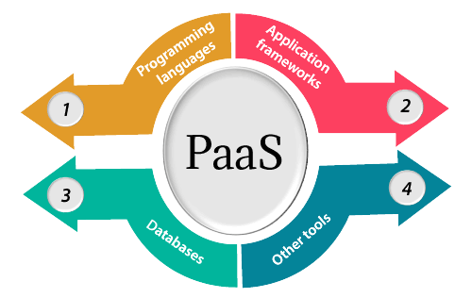
BITSYM
Platform as a Service
Bitpredict API can be hosted on any cloud service
Can integrate a multiplicity of sensors, devices, and artificial intelligence algorithms using standard Industrial Internet of Things protocols
Every customer has their own view of processes, sub-facilities, and facility
Digital twins and predictive analytics for informed real-time alerts, prediction, and decision making
Accessible on both desktops and hand-helds from anywhere with IP connectivity

Slide 17
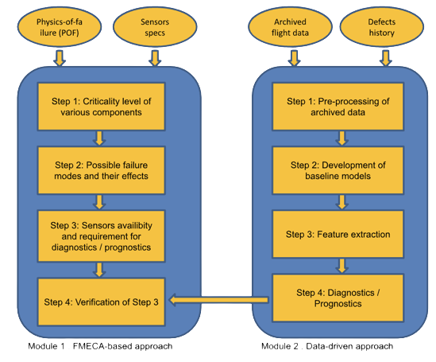
BITSYM
Integrated Vehicle Health Management (IVHMS) System
Objective:
This objective of health management is achieved by utilizing real-time sensor data in conjunction with physics-of-failure (POF) knowledge.
Scope:
In our case, IVHMS is to be designed for the following 4 aircraft systems.
Engine
Structures
Avionics
Support systems

Slide 18

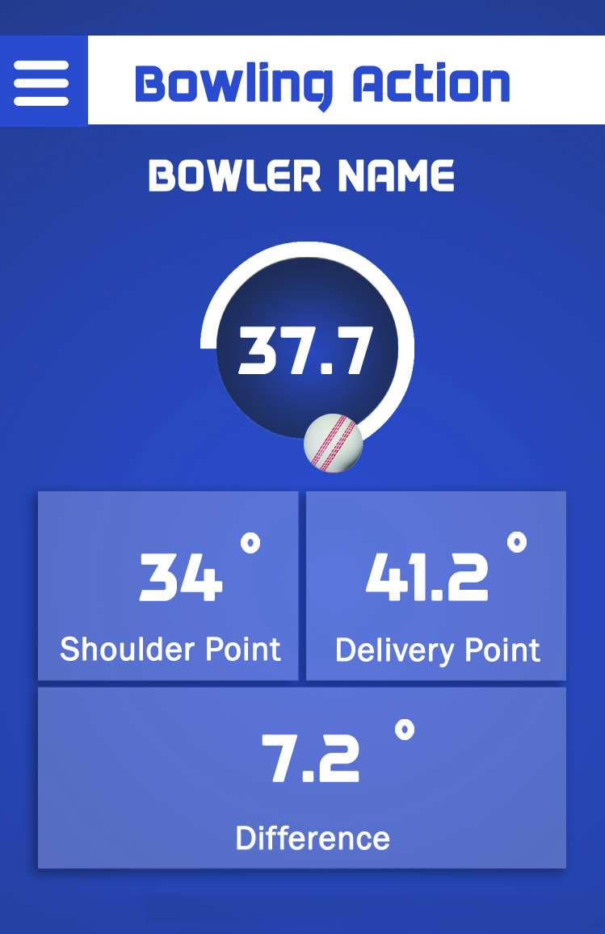
BITSYM
Criccoach
Business Challenge:
To monitor bowler athlete arm action and speed of ball release in real-time
Business Aims:
Real-time bowl release monitoring
Real-time speed of bowl assessment
Detect any deviation in the angle of release from regulatory guidelines
Solution:
Acquisition of arm data through sensors and wireless radios
Predictive modeling of machine data
Real-time detection of anomalies in arm action
Android application with cloud support

Slide 19
BITSYM
Software Solutions

Slide 20
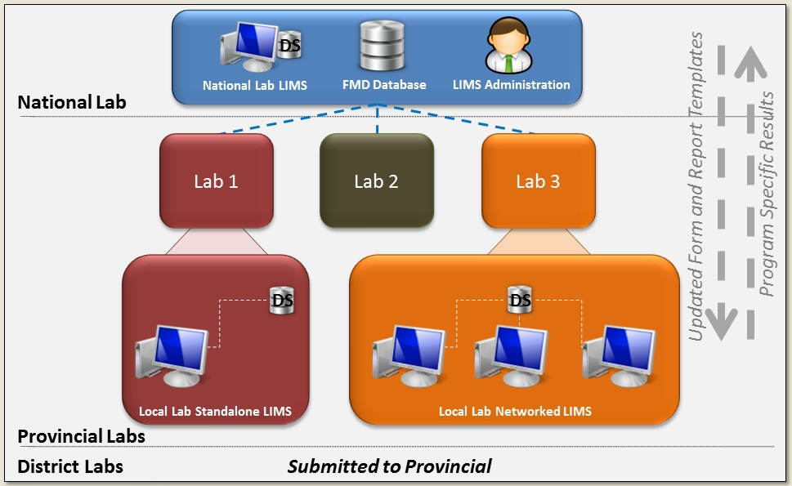
BITSYM
National Laboratory Information Management System
Business Challenge:
Management of disease data across 15 national veterinary laboratories
Business Aims:
Develop a National Laboratory Information Management System (LIMS) used by lab technicians, doctors and experts to store, share and review information / data about FMD.
Help store information regarding foot and mouth disease samples
Treatments, prevention, general health status of the regional livestock.
Solution:
Full fledge desktop application for nation-wide reporting of case data
Ability to work in both online and offline modes
Real-time reporting of positive disease detection

Slide 21
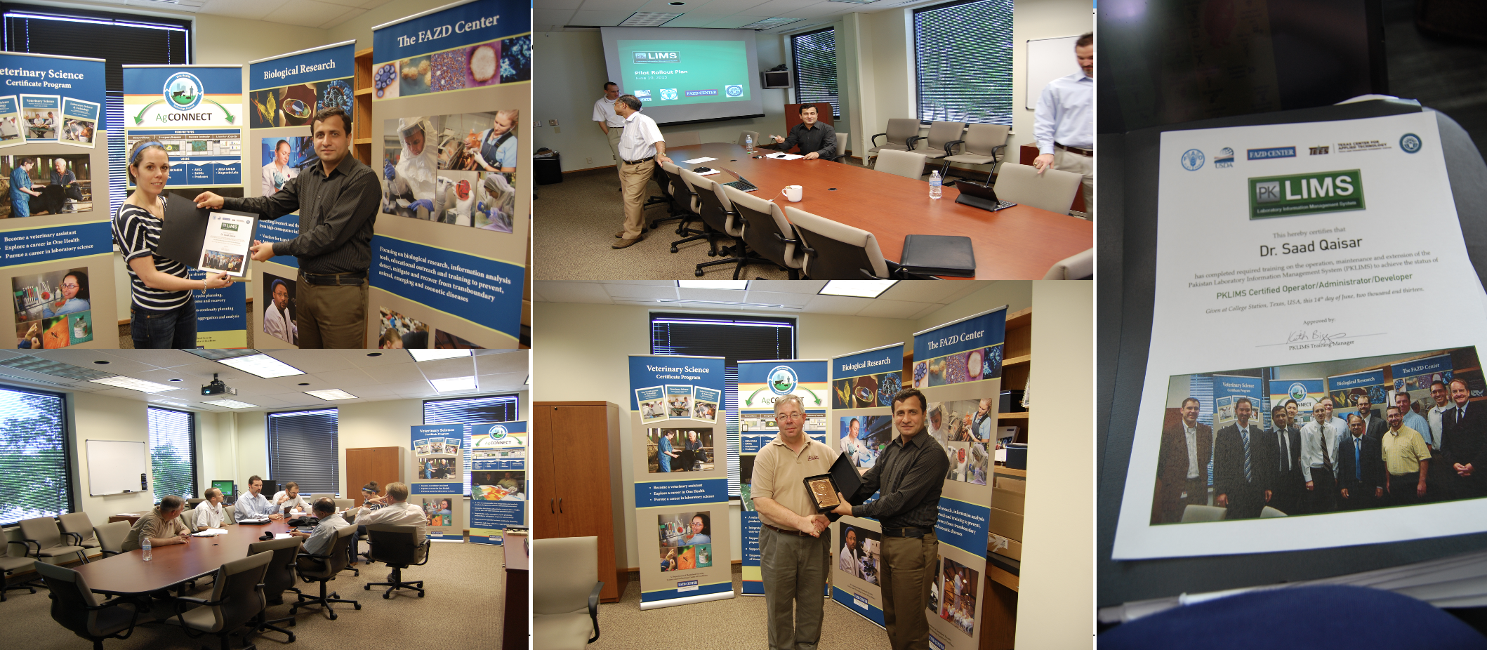
BITSYM
National Laboratory Information Management System

Slide 22
BITSYM
Fund Raising Web Solution
Implemented a fundraiser solution for a major US-based client
Funds raised through crowdsourcing
Implemented all details for funding from scoping to implementation, payment gateways integration
Provided PCI compliance and security audits services
More than 100,000 users to date (2023) and growing

Slide 23
BITSYM
Semiconductors

Slide 24
BITSYM
NFC Tags for Smart Stores
NFC tag

Slide 25
BITSYM
BLE Beacon

Slide 26
BITSYM
WiFi Smart Scales

Slide 27
BITSYM
Telecommunications
and Networks

Slide 28
BITSYM
Xbits: A Differentiated Services SDN Enabled Internet Exchange Point
At the SDX, ISPs can apply many diverse actions on packets based on multiple header fields, and distant networks can exercise “remote control” over packet handling.
In this work, we would design and implement a software-defined internet exchange point in Pakistan. Specifically, we would focus on the following goals:
Developing customized architecture of SDX
Implementation of the architecture
Validation of SDX architecture through peering
Development of a services brokerage
Offering of SDX differentiated services to local ISPs.

Slide 29
BITSYM
Xbits: A Differentiated Services SDN Enabled Internet Exchange Point
General goals for SDN
More Control Of Our Network!
Active Control Plane – not just during maintenance!
Policy Management
better than VLANs, Subnets, Firewalls, IDS, IPS, etc
Active Projects in:
Network access control
Wide-area video distribution
Capacity Monitoring and Management
Simplified Configuration - “virtual patch panel”
Security, Data Privacy

Slide 30

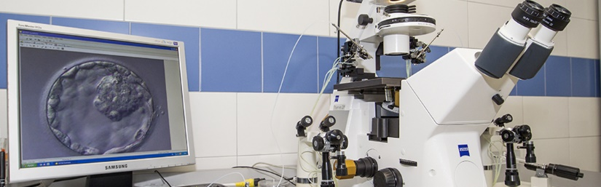
BITSYM
Remotely Operated Real-Time Cell Injection System
Business Challenge:
To perform semi-automated cell injection
Business Aims:
Injection into a cell target elements
Real-time remote monitoring
Control through a joystick
Solution:
Remotely operated micro cell injection system
Both hardware and software developed inhouse
High manoeuvrability

Slide 31
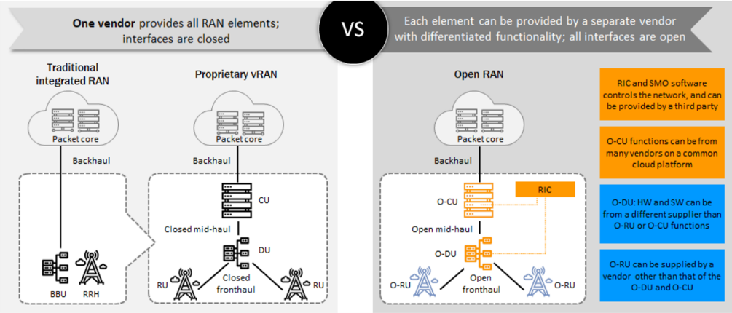
BITSYM
Design of xApp & rApp for the Optimization of Open Radio Access Network (O-RAN)

Slide 32
BITSYM
AI ML
Design of xApp & rApp for the Optimization of Open Radio Access Network (O-RAN)
The use of ORAN architecture in 5G networks poses new challenges in terms of radio resource management, particularly in terms of managing the Physical Cell Identifier (PCI) collisions.
We went over the service management and orchestration (SMO) framework in depth. Furthermore, we investigate the used case of O-RAN, which is a PCI collision, and conclude our research with potential solutions.
Several solutions have been proposed to address the PCI collision problem in ORAN, including dynamic PCI assignment, centralized PCI management, and distributed PCI management.
But here we are resolving PCI collision issue in ORAN by utilizing Vmware centralized RIC (Rapp) and Aws cloud virtual machine.
On the simulator, rApp were also implemented. Also, we run demo rApps by utilizing Vmware centralized RIC (Rapp) and Aws cloud virtual machine.

Slide 33
BITSYM
Computing

Slide 34
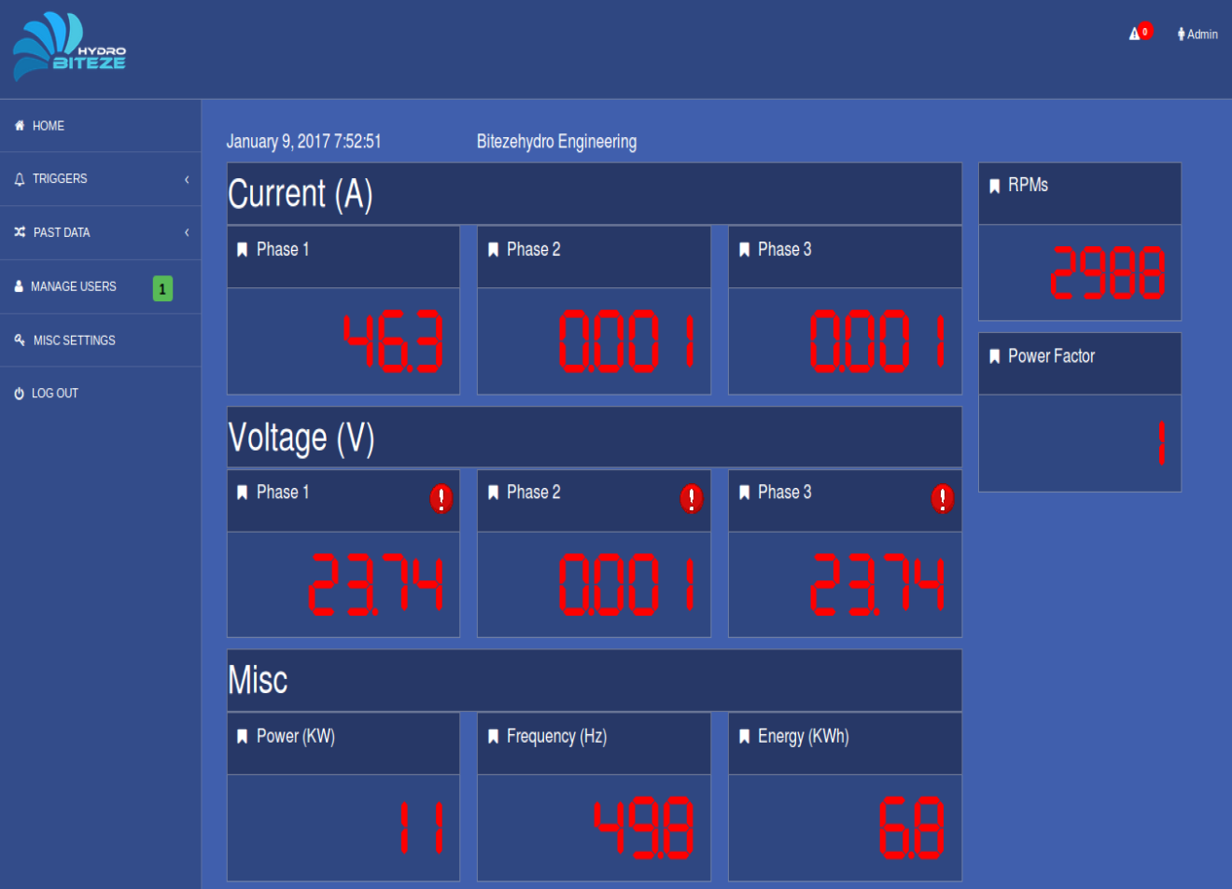
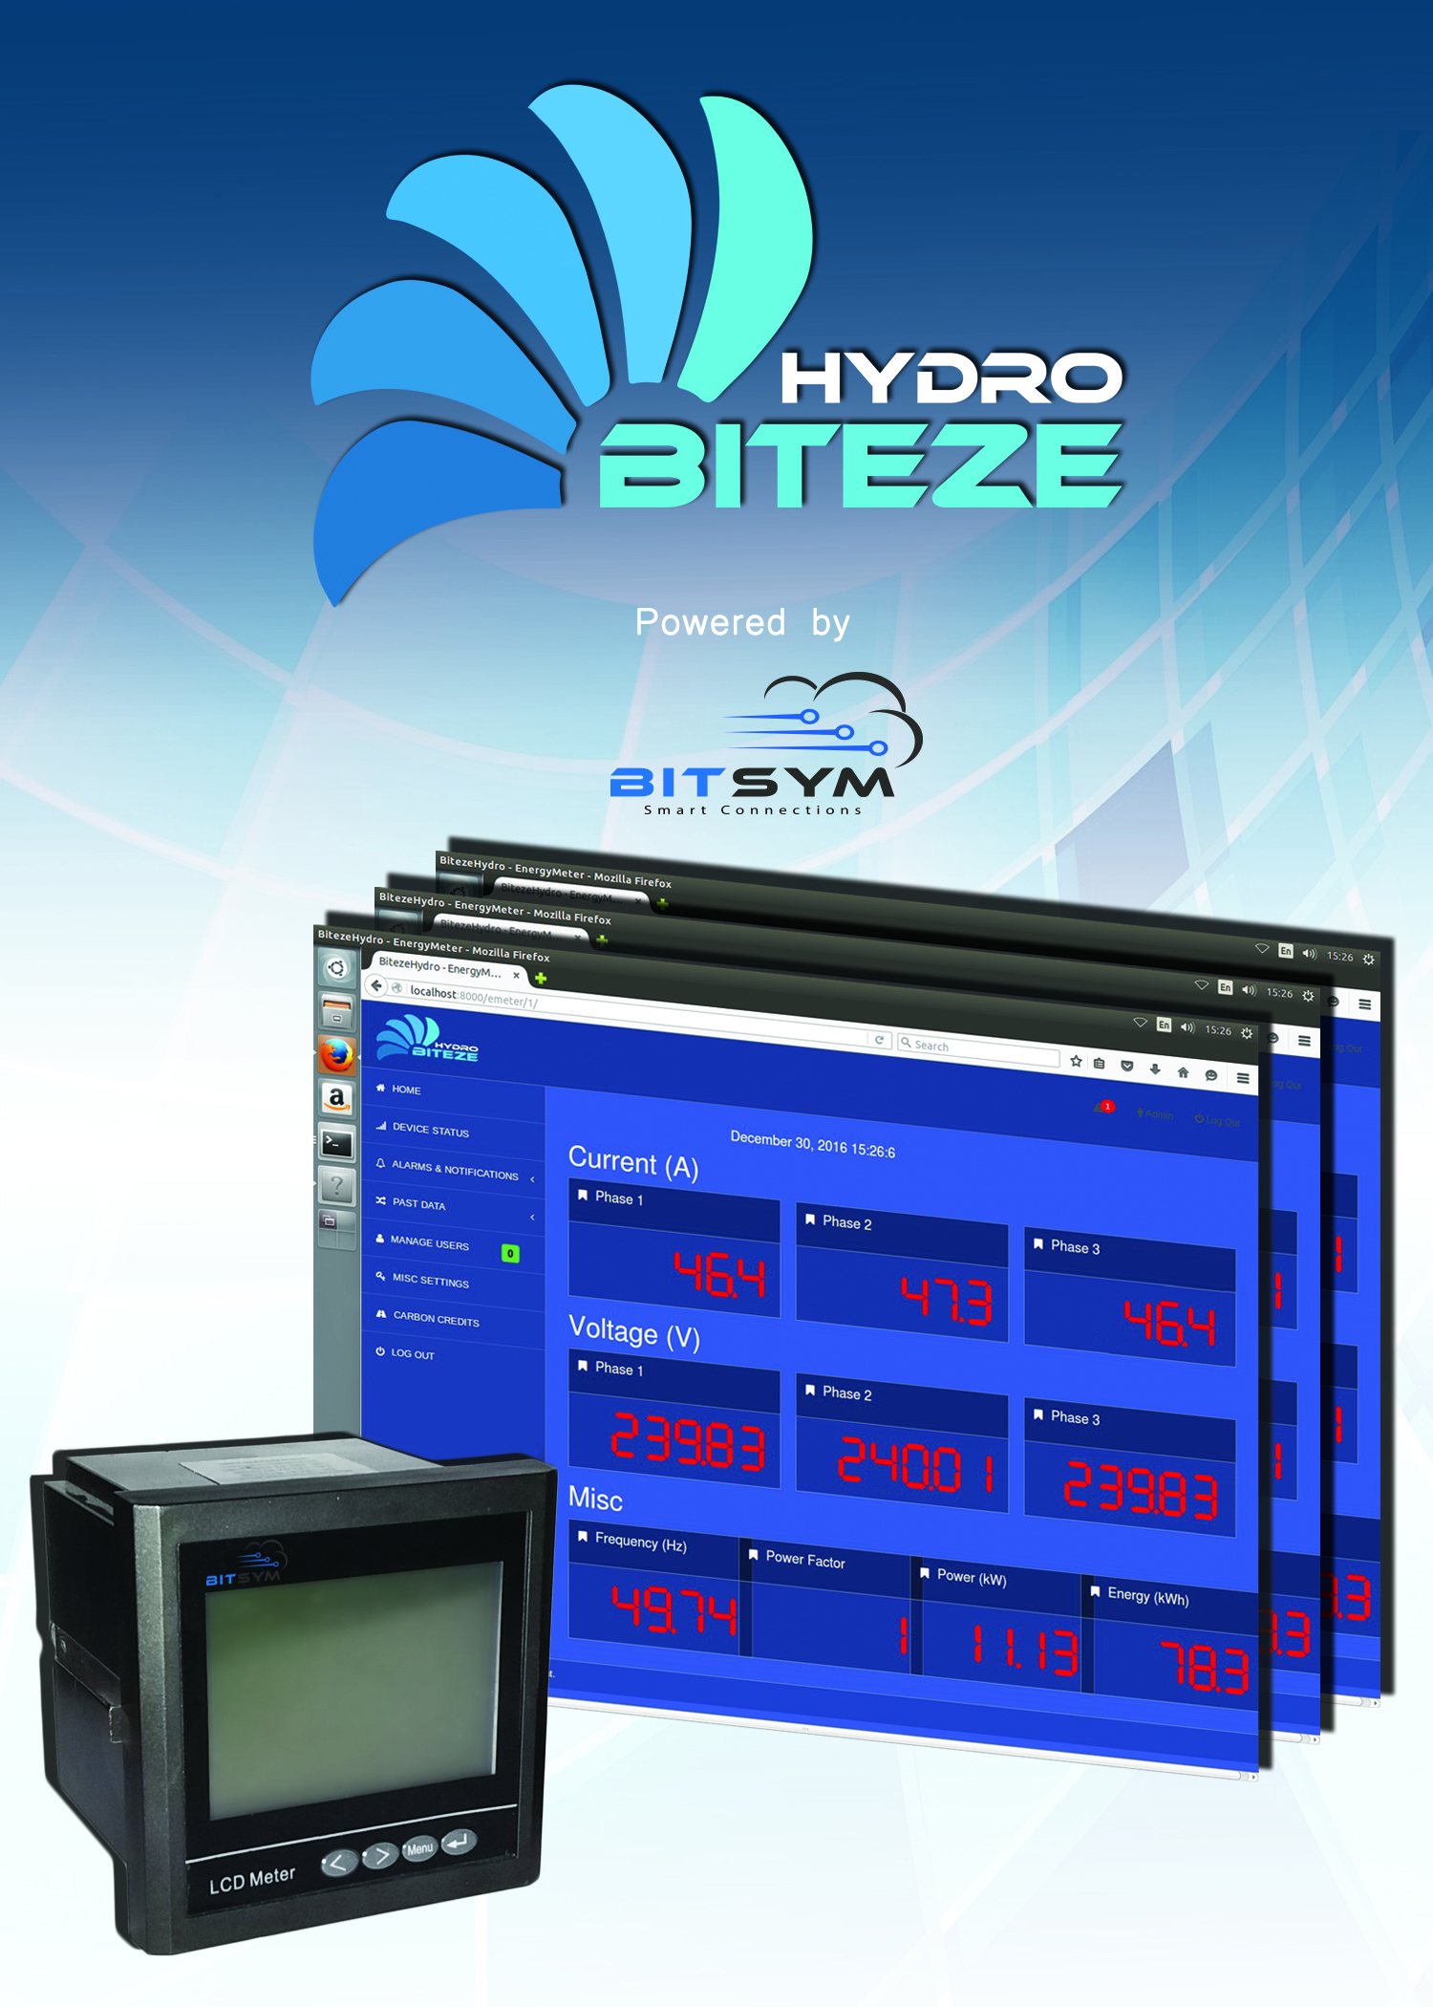
BITSYM
Biteze: Remote Monitoring System
Business Challenge:
To monitor, log and report key micro-grid parameters
Business Aims:
Fine granular micro-grid situation awareness
Typical use cases for solar, batteries and hydro power applications
Solution:
Acquisition of power data through sensors and machine logs
Periodic reporting on Internet Protocol

Slide 35
BITSYM
Wireless Healthcare Monitoring System
Introduction:
Global shortage of healthcare services and professionals.
Context-aware ubiquitous wearable systems are taking healthcare to the next level.
Continuous monitoring of ICU, post-op, and old age patients simultaneously on the mobile phone.
Objectives:
Continuous monitoring of vitals (HR, RR, BP, Temp)
Compact patch-based form factor
Integration with CDSS/Health records database

Slide 36
BITSYM
Other Projects
Watercense: Water Quality Monitoring System
GIZ: System for Monitoring of National Electrical Grid
WHO-UNFAO National Biosurveillance Program
BLE Beacon: Bluetooth Radios for Localization
Fog-Assisted SDN Controlled Framework for Enduring Anomaly Detection in an IoT Network
Deep Packet Inspection
Safety assurance in high stress environments
Reliable Monitoring of oil and gas pipelines using wireless sensor networks

Slide 37




















BITSYM
Clients and Partners

Slide 38
BITSYM
Achievements
Artificial Intelligence domain
National Technology Development Fund (TDF) grant – Spring 2018
Ignite ICT fund grant - 2018
UNIDO (United Nations) Open Innovation - Winner 2017
UNIDO (United Nations) Open Innovation - Runner-up 2015
Collaboration with WHO (World Health Organization)
Collaboration with GIZ, Germany

Slide 39
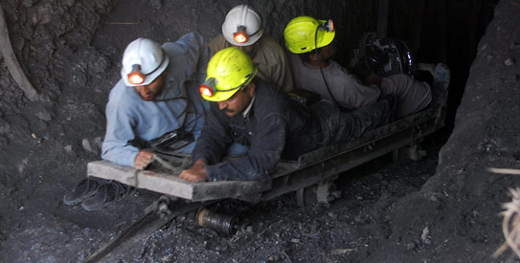
BITSYM
Achievements
Safety Assurance in High Stress Environments
Funding: USD 170,000
Source: ICT R&D Fund, Pakistan
Status: Delivered
Scope: Safety assurance of workers and infrastructure in harsh environments such as mines
Localization
RF Communication
Networking

Slide 40
BITSYM
Achievements
Development and Deployment of National Laboratory Information Management System
Funding: USD 1 million
Source: United Nations Food and Agriculture Organization/World Health Organization
Scope: Develop a National Laboratory Information Management System (LIMS) used by lab technicians, doctors and experts to store, share and review information / data about FMD.
Help store information regarding:
foot and mouth disease samples
treatments, prevention, general health status of the regional livestock.
Collaborating Partners/Customer:
National Veterinary Laboratories
UNFAO
USDA
Texas A&M University, USA
World Health Organization

Slide 41
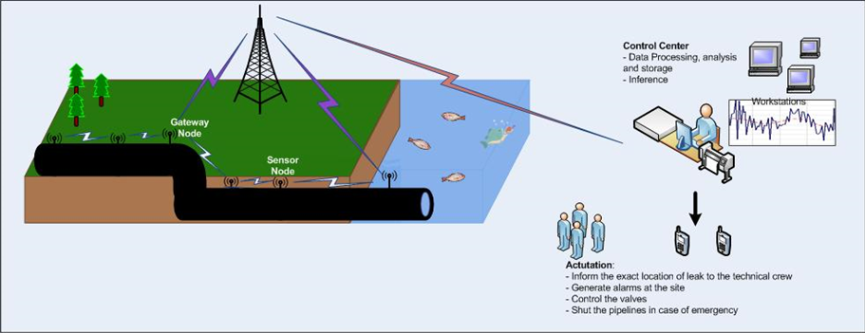
BITSYM
Achievements
Reliable Monitoring of Oil and Gas Pipelines Using Wireless Sensor Networks
Funding: USD 5,50,000
Source: King Abdul Aziz City of Science & Technology (KACST), Saudi Arabia
Partner: Umm-ul-Qura University, Mecca, Saudi Arabia
Scope: Develop an integrated end-to-end solution for Oil and Gas pipeline monitoring using WSNs
Status: Delivered

Slide 42

BITSYM
How to reach us?
www.bitsym.com | services@bitsym.com
Facebook | Twitter | LinkedIn
Sales Office, Michigan USA
East Lansing, MI 48823, USA
+1 517 775 7445
Engineering Office, Islamabad Pakistan
Bitsym Arcade, Plot 239, 240, Sector D18, Block G, Islamabad.
+92 33 5580 5580 +92 333 5260730
Technical , Sales and After Sales Support Office, Canada
Toronto, Ontario, Canada
+1 647 544 0167

